Slide 1
Calgary Private Cab Service
Gokalp Aydinak

Slide 2
Topics
Introduction
Business Scenario
Methodology
DATA
Data Analysis – First Step
Data Analysis – Second Step
Foursquare API
Clustering Analysis
Final Results & Visuals
Conclusion

Slide 3
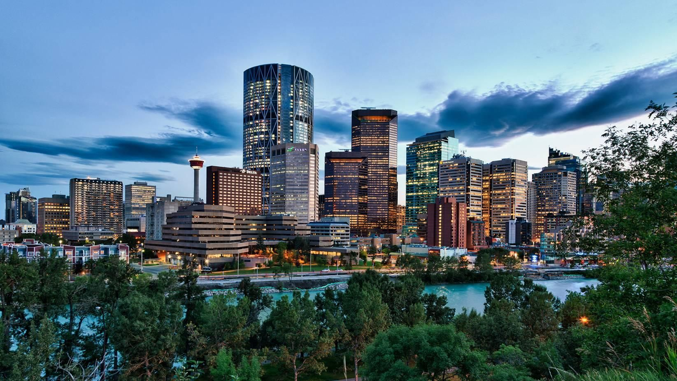
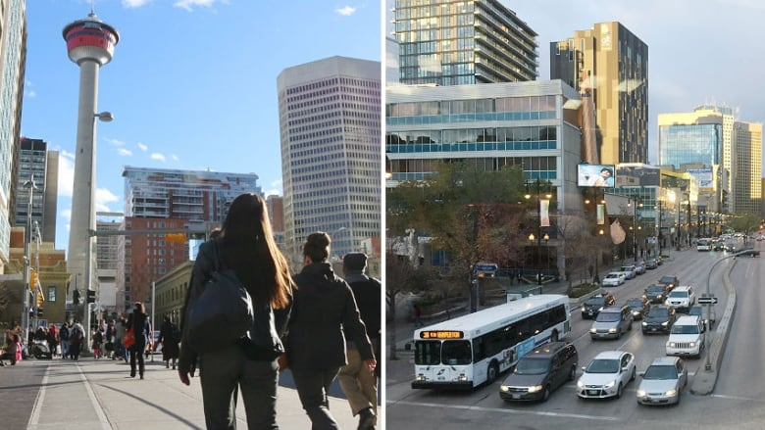
Introduction
Calgary
A city in the western Canadian province of Alberta
Population of 1,285,711
Alberta's most-populous city & 4th largest in Canada
Diverse economy: Energy, financial services, tech, etc
2nd highest number of corporate head offices: 800
Highest number of millionaires per capita in Canada
Business Interest
High demand from local citizens and businessmen
A private investment firm will establish a Private Cab Company in Calgary
Business should be cheap, functioning at highest standards, and profitable.

Slide 4
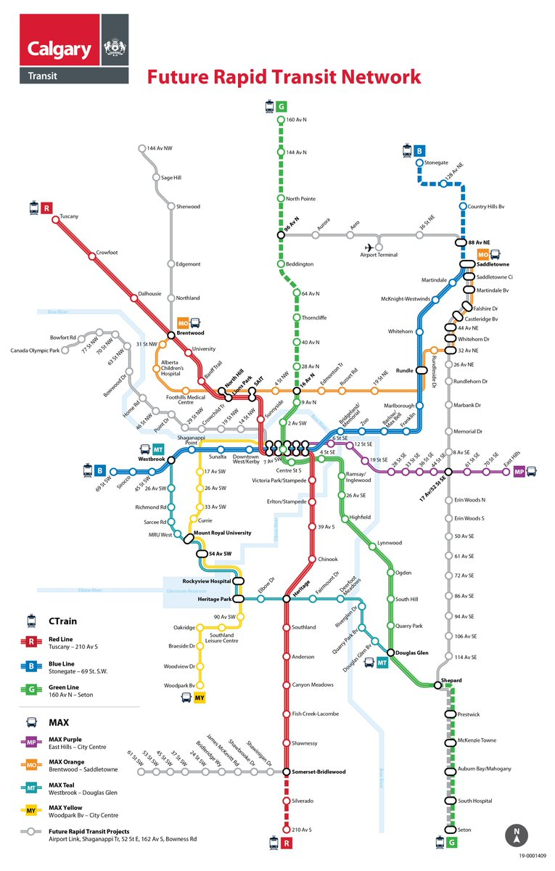
Introduction
Background Information
Calgary is divided into four quadrants: NW, SW, SE or NE.
Avenues run east-west, streets run north-south.
One of the most geographically dispersed city in the world.
Housing and buildings are separate and detached.
Public transport system is not as comprehensive as those seen in other large Canadian cities
Citizens heavily depend on personal vehicles.
Travelling is tricky when travelling between quadrants and heavy traffic congestion during rush hours.
Hefty parking costs, High insurance costs

Slide 5
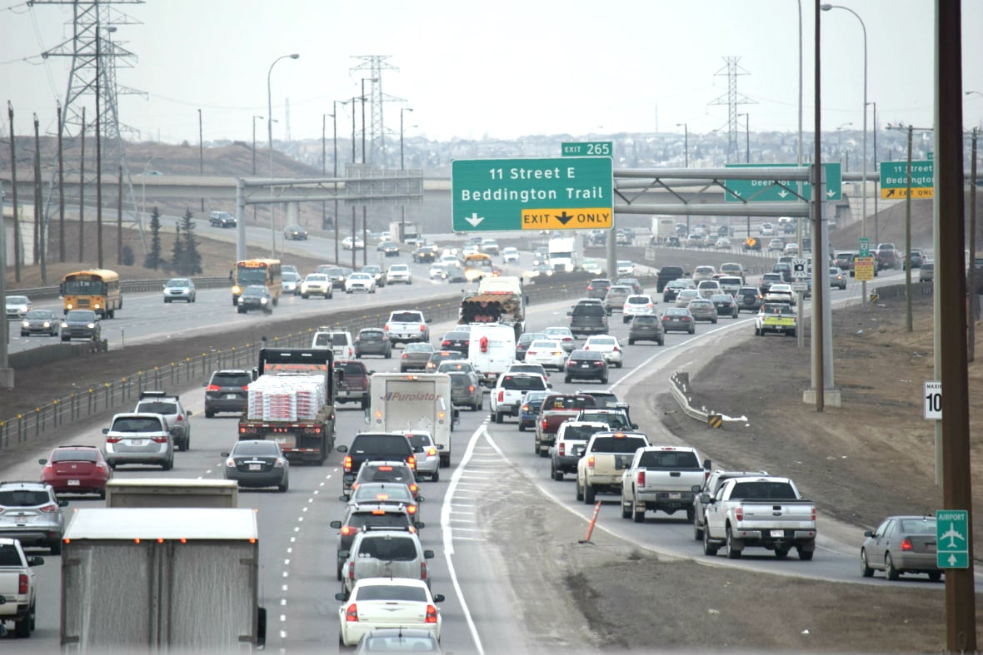
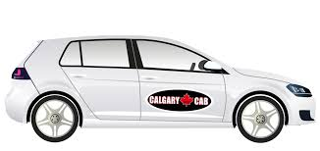
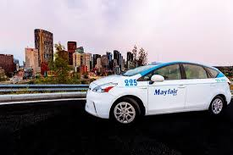
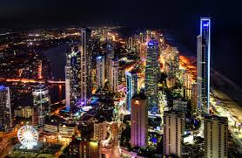



Business
Challenges
Opportunities
One of Canada’s most-populous city
Many commercial & industrial enterprises
Rich economy & customer profile
24/7 busy life & Attractive Places
Younger generation & colleges
Heavy traffic congestion during rush hours.
Travelling is tricky when travelling between quadrants
Heavy traffic congestion during rush hours.
High Safety & Health Standards
Increasing unemployment rate
Increasing Competition
Attracting Customer’s attention
Up & Downs in Economy
Increase in gasoline prices

Slide 6
Business
Business Scenario
Initial investment cost will be high due to quantity of the branches and cabs. Therefore to be profitable:
A “Cab Service App” will be commercialized on all platforms. This platform will be the interface between company & customers. Some of the important features of this app are requesting a cab through the app as well as direct calling platform, giving feedback for the drivers and seeing estimated driving hours.
Branches must be close to all potential customers. Especially to highly populated neighborhoods and business areas.
Driving hours are very critical both for the customers and drivers.

Slide 7
Methodology
To reach all the customers and optimize the driving hours, several branches will be located on different parts of Calgary.
In fact, quantity and size of the branches will be determined after data analysis.
Methodology will be as following:
1st Step
Analyze, classify, visualize, categorize the data
2nd Step
Determine Hot spots - Universities, libraries, restaurants, etc.
3rd Step
Access to Foursquare API to collect venues data around hotspots.
4th Step
Most attractive areas will be clustered.
Initial visualization for “Cab Services” – 1st Map
Parsing missing data and combining into main data frame
Finding location coordinates
Secondary visualization for “Cab Services” – 2nd Map
Venues json file will be generated to classify venues
Clustered venues and population data will be combined to define & visualize best branch locations for cab services. –Final Map
Search, find, capture and clean the data – Census & Services Data

Slide 8
Data
Sources
Datasets
Calgary data website - great source for data scientists
Many datasets related to Calgary such as crime rate , population data, businesses data, housing data.
For more information refer to link below:
https://data.calgary.ca/
https://data.calgary.ca/Demographics/Census-by-Community-2019/rkfr-buzb
2 datasets
“Calgary Census by Community Data”
“Calgary Community Services”.
Former dataset for neighborhood names, class of neighborhoods (residential or business), Sectors where the neighborhoods belong to, population of each neighborhood, count of dwellings in each neighborhood, etc.
Latter dataset for attractive places (Museum, health center, community centers, etc), their neighborhoods, address, location coordinate data.
Libraries
Matplotlib
Numpy
Pandas
Geopy
Beautifulsoup
Sklearn
Folium - Map

Slide 9
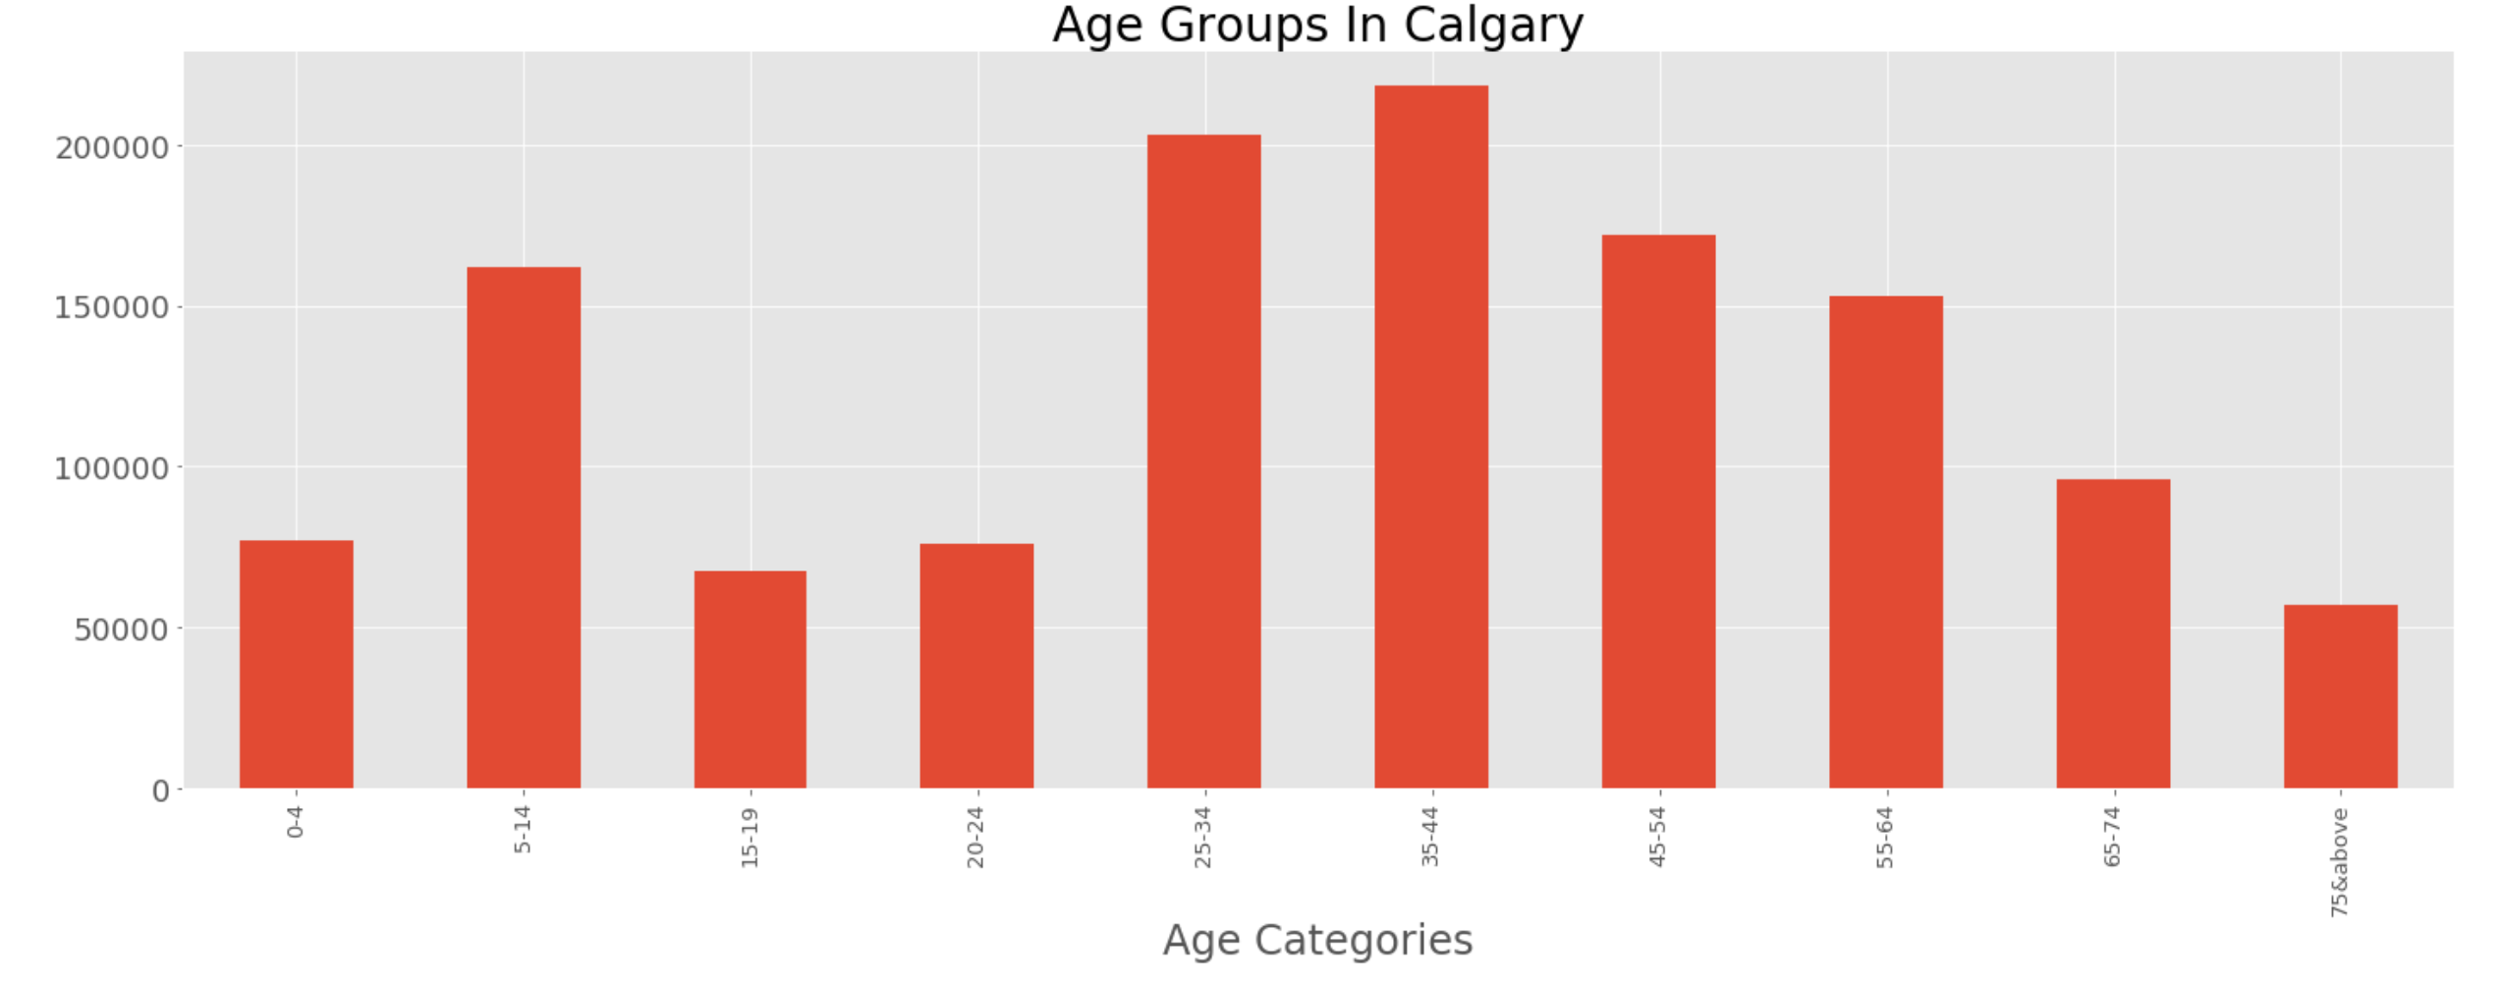
Data Analysis – First Step
Cleaning, Modification, Updates, Selection
“Calgary Census by Community Data” has been filtered, cleaned, missing data filled in, wrong data has been corrected. (Static Population Data)
Final dataframe has been sorted & highly populated neighborhoods have been defined.
Initial Analysis
Calgary has a diversified age group
Majority of the people are working and studying class
People need and can afford private cab services in their daily life.

Slide 10
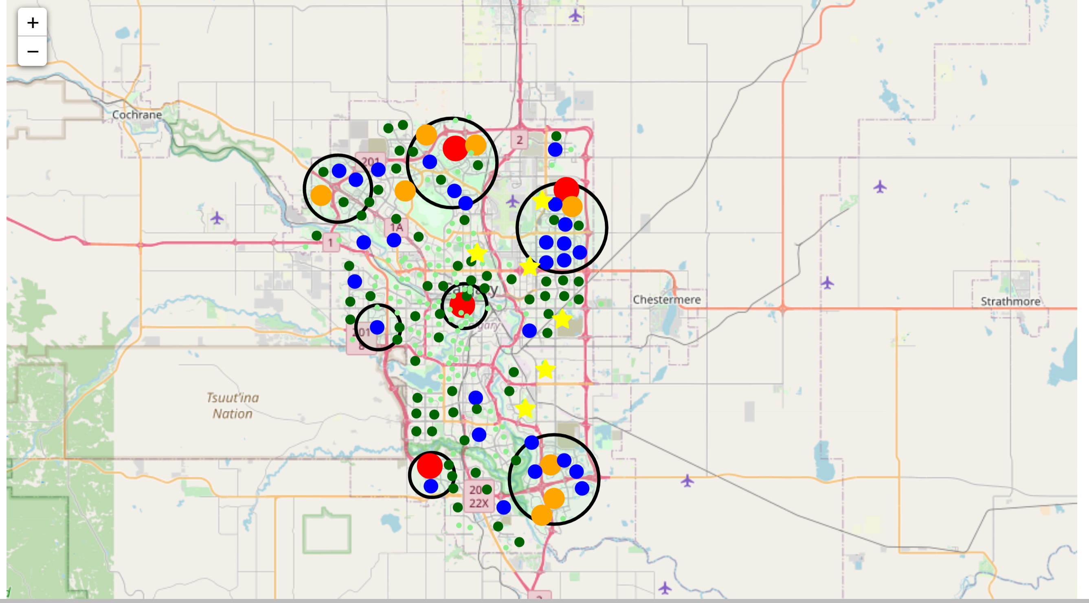
Data Analysis – First Step
Initial Results & Visuals
7 black circles - Optimum areas for the branches
Black circle Size – Branch Size
“Yellow Stars” - industrial areas.
All colored circles have radius proportional to their population range mentioned as below:
Red - Neighborhoods > 20,000
Orange - 15,000 < Neighborhoods < 20,000
Blue - 10,000 < Neighborhoods < 15,000
Dark green – 5,000 < Neighborhoods < 10,000
Light green - Neighborhoods < 5,000
Without venues data it will be really hard to say if citizens are just visiting nearby places or travelling around the city.

Slide 11
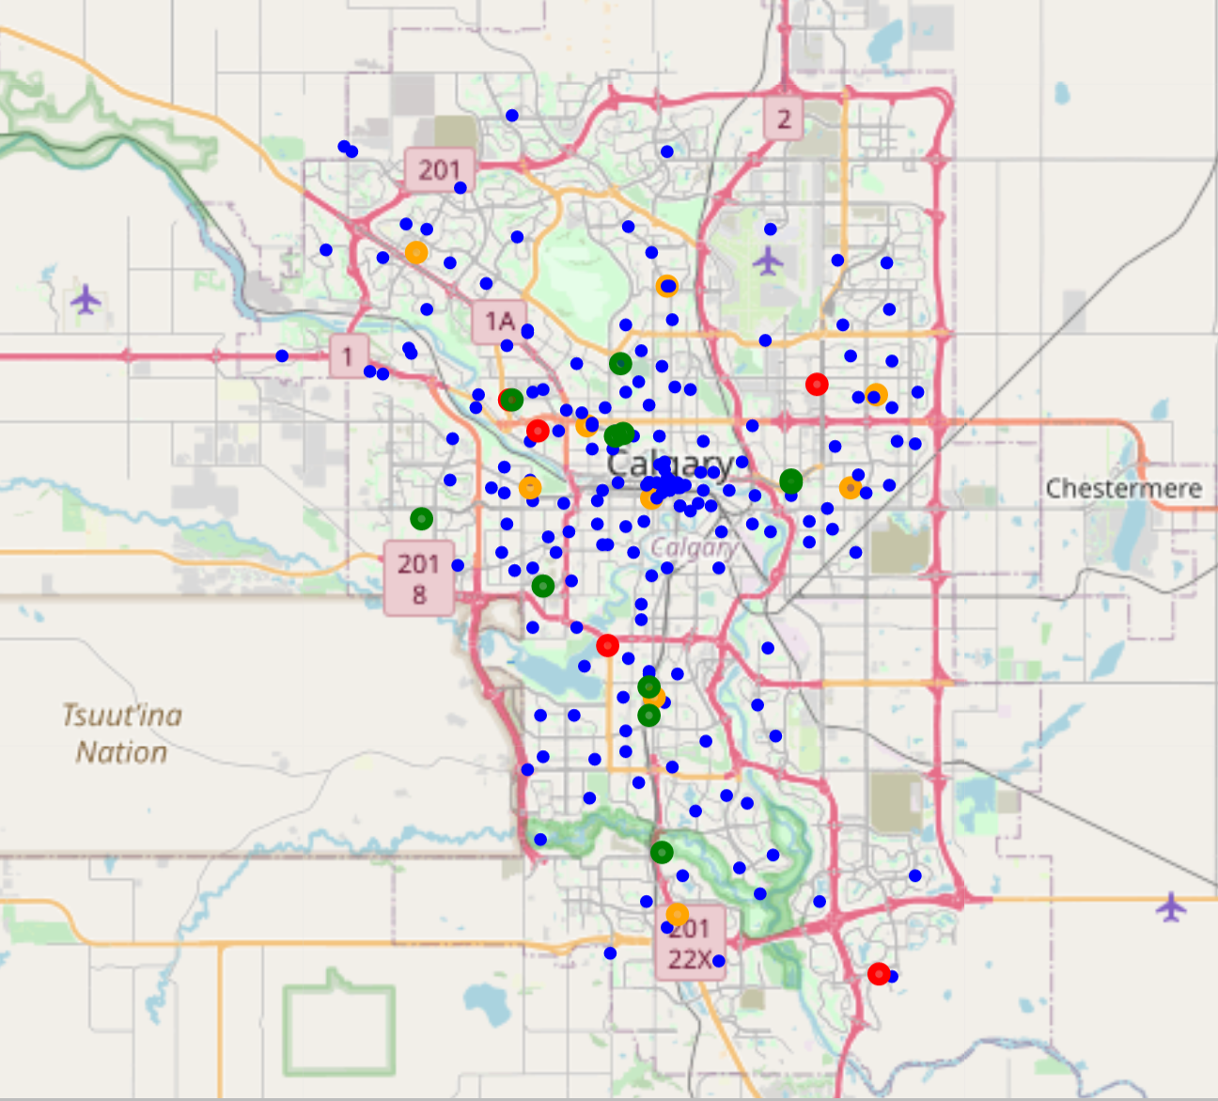
Data Analysis – Second Step
Cleaning, Modification, Updates, Selection
“Calgary Services Data” has been filtered, cleaned, missing data filled in, wrong data has been corrected. (Dynamic Population Data)
All attractive places data have been defined but colleges data were missing.
College names were scraped through wikipedia and added into main dataframe.
Hospital = Red Circle
Clinic = Orange Circle
Universities = Green Circle
Rest = Blue Circle
Initial Results & Visuals

Slide 12
Foursquare API
Foursquare API have been used to collect venues information around these hotspots.
Search is limited to 1000m radius of each hot spot
Quantity is limited to 100 venues.
All venue names are defined, and their URL addresses are collected.
JSON file for all the venues are collected.
All the venue names and their location coordinates are grouped under same neighborhood names and their presence frequency are defined for each neighborhood.
Finally, only top 10 venues are selected and sorted under “neighbourhoods_venues_sorted” dataframe.

Slide 13
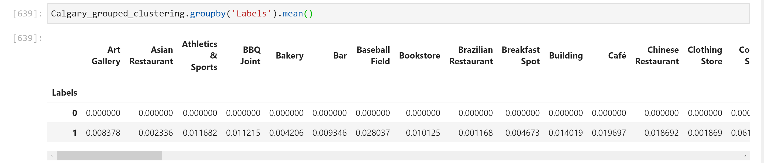
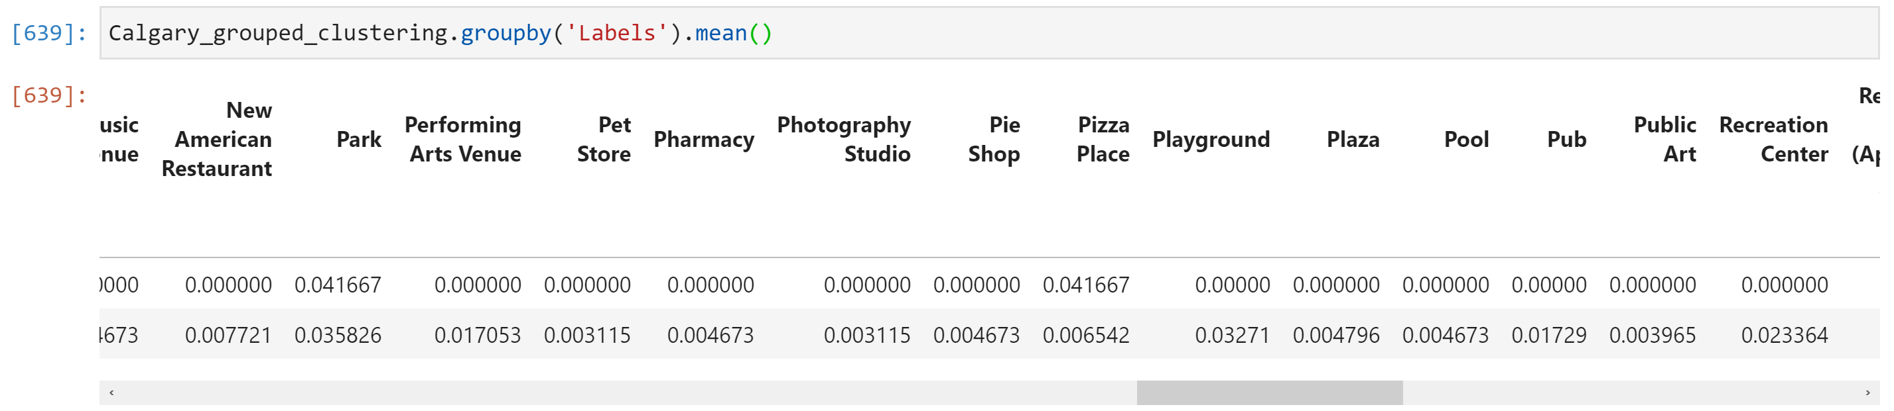
Clustering Analysis
Clustering helped on defining neighborhoods that have most diverse venues options for citizens.
These areas will directly indicate highest customer potential areas for the Private Cab Services.
Most optimum clustering quantity was 2 which clustered most and least attractive neighborhoods.
Cluster Label “0” = Least attractive
Cluster Label “1” = Most Attractive

Slide 14
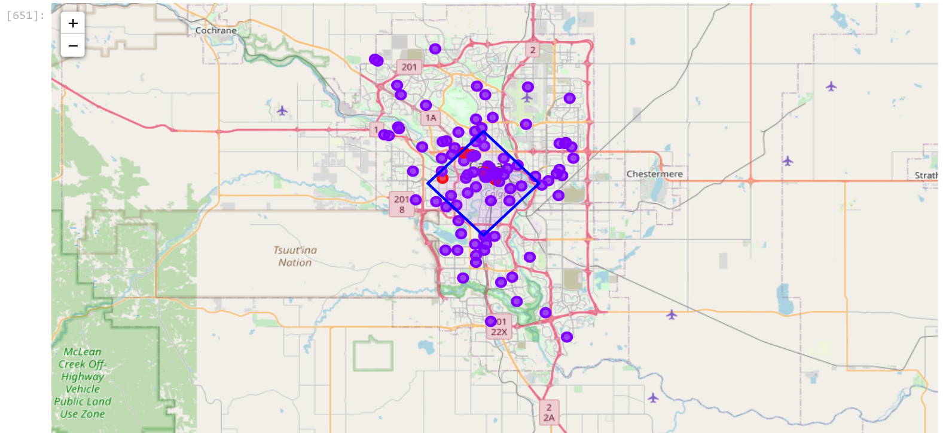
Final Results & Visuals
Cluster map that indicates most and least attractive zones.
Center of Calgary (Blue Rhombus) - Most attractive neighborhood
All different type of venues are located in this area
Most promising place in Calgary for finding customers
Best place for the main office (headquarters).
Neighborhoods are clustered in to 2 categories.
Purple – neighborhoods with most attractive \ diverse venues.
Red - neighborhoods with least diverse venues.
Blue rhombus - most diverse venues area
Center of Calgary is the best place for headquarters.

Slide 15
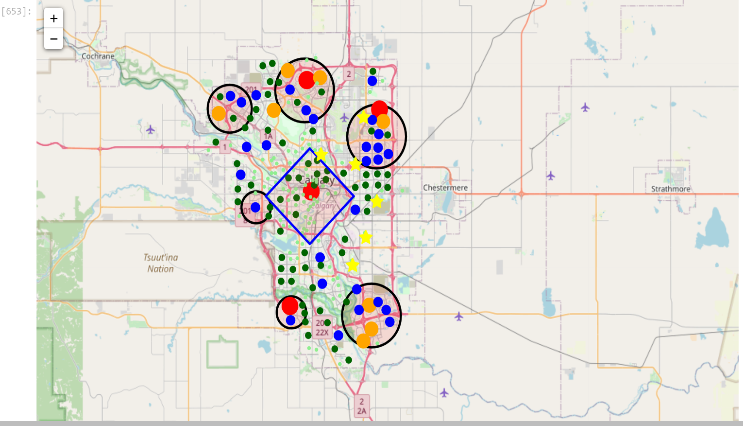
Final Results & Visuals
Results from clustering analysis are combined with the results obtained from population analysis Data (Data Analysis 1st Step).

Slide 16
Conclusion
7 branches will be located as following:
Main Branch - Rhombus @ the Center
Big Branches - Big Circle North, Big Circle North East, Big Circle South East
Small Branches – Small Circle West, Small Circle North West, Small Circle South West
All important areas are covered
Most profitable way to establish Branches connections
Some other important results are:
Industrial areas are on the eastside
Highly populated areas are on North, East, South East, Center and South West areas
Most attractive neighborhoods are located in the central part of Calgary.
This study can be further extended by analyzing crime rate, population-age demographics, road conditions, competitor analysis, fuel consumption rate per km, city shop rental prices, etc.

Slide 17
Thanks

